Slide 1
Asynchronous Programming and Collection in Dart
MODULE - 4

Slide 2
INTRODUCTION
Asynchronous programming :
Asynchronous programming means executing tasks without waiting for other tasks to complete.
It helps programs remain responsive, especially when performing time-consuming operations.
COLLECTIONS IN DART :
Collections are used to store and manage groups of objects or data.
The most common collection type in dart like lists , sets , maps and queue.

Slide 3
ASYNCHRONOUS PROGRAMMING IN DART
FUTURES :
A Future represents a value or error that will be available at some time in the future.
It is used for asynchronous operations that return a single result.
STREAMS :
A Stream can emit multiple values over time.
You can listen to a stream to receive data continuously.

Slide 4
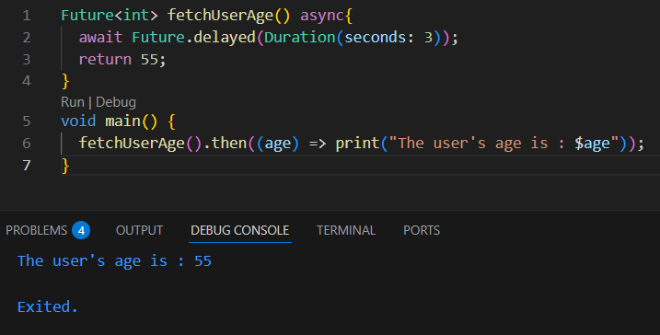
EXAMPLE OF FUTURE

Slide 5
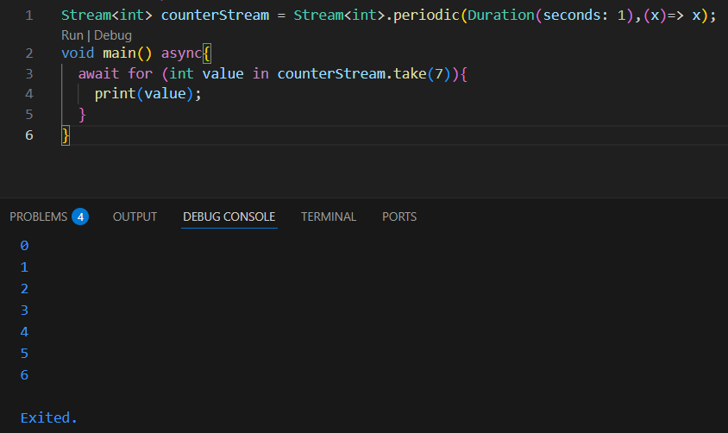
EXAMPLE FOR STREAM

Slide 6
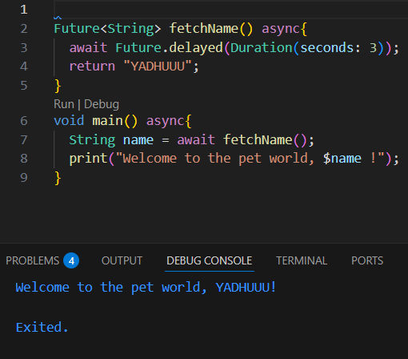
ASYNC and AWAIT
ASYNC :
async makes a function asynchronous.
It allows using await inside it.
It returns a Future automatically.
Keeps the program non-blocking and responsive.
AWAIT :
await can only be used inside a function marked with async.
The function pauses at await, but the rest of the program keeps running.

Slide 7
COLLECTION IN DART
LIST
SET
A List is an ordered collection of items (like an array).
Each element has an index starting from 0.
A Set is an unordered collection of unique elements.
No duplicate values allowed in set
MAP
QUEUE
A Map stores data as key–value pairs.
Keys must be unique and each key map to a value.
A Queue is a collection that follows the FIFO (First In, First Out) rule.
Elements are added at one end (rear) and removed from the other (front).

Slide 8
LIST
FIXED LENGTH LIST
GROWABLE LIST
A fixed length list has a constant size.
It cannot add or remove elements after it is created.
It can change the values of existing elements.
A Growable list can increase or decrease in size dynamically.
It can freely add , insert, or remove elements.
Used commonly in most Dart programs.

Slide 9
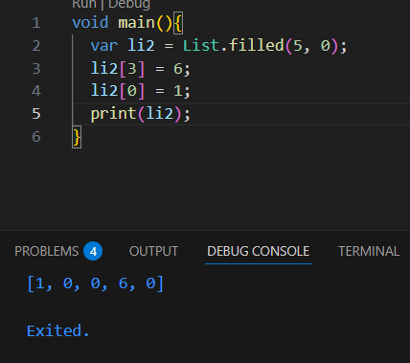
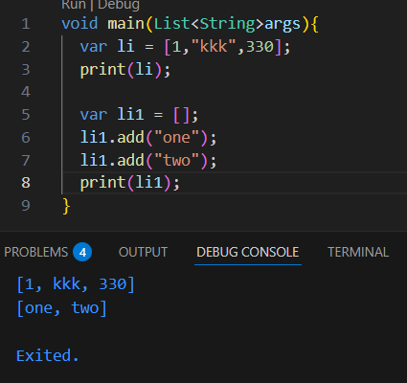
FIXED LENGTH LIST
GROWABLE LIST

Slide 10
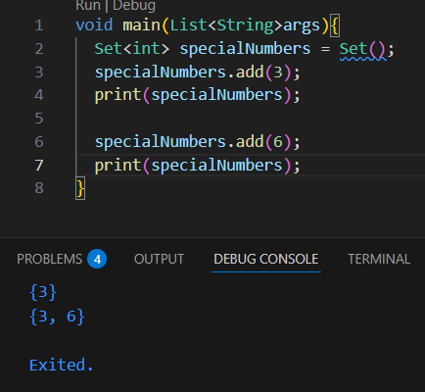
SET

Slide 11
MAP
MAP LITERALS
MAP CONSTRUCTOR
A Map literal is the simplest and most common way to create a map in dart.
Use curly braces { } with key value pairs inside.
Commonly used for static key value data.
A Map constructor uses the Map class to create a map using the Map() constructor.
Creates an empty map that you can add items to later.
Good for building maps dynamically(during runtime)

Slide 12
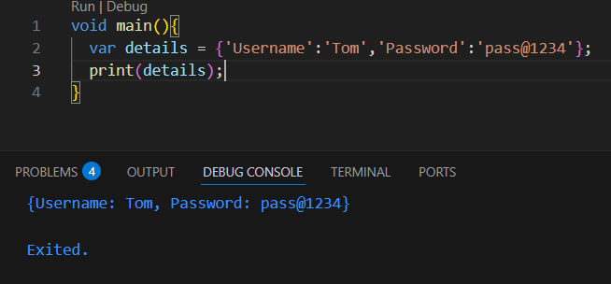
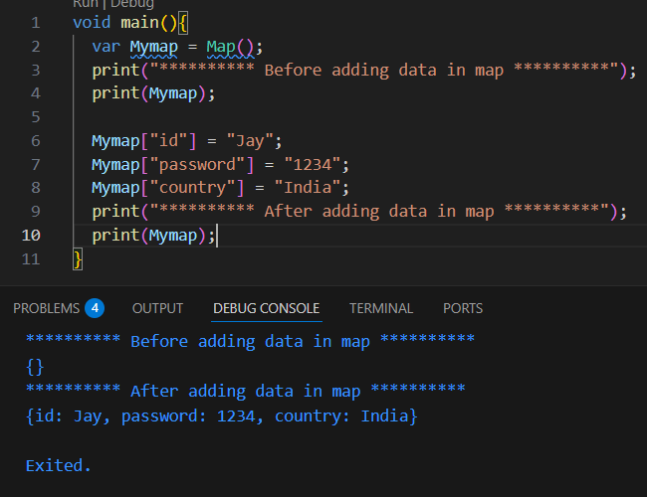
MAP LITERALS
MAP CONSTRUCTOR

Slide 13
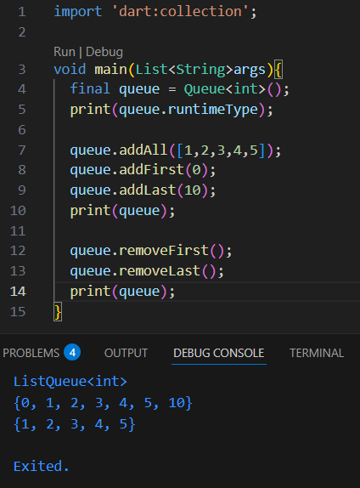
QUEUE

Slide 14
ADVANCED DATA STRUCTURES IN DART
TREE
GRAPH
A tree is a hierarchical data structure made up of nodes.
It start with a root node and branches out into child root.
Has only one root node
A graph is a collection of nodes connected by edges.
It can be directed or undirected.
It can contain cycles.

Slide 15
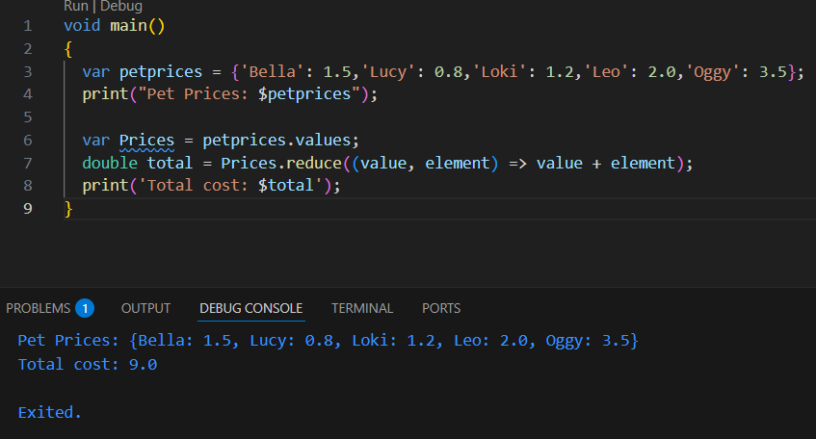
EXERCISE - 1
MAP
IN
DART

Slide 16
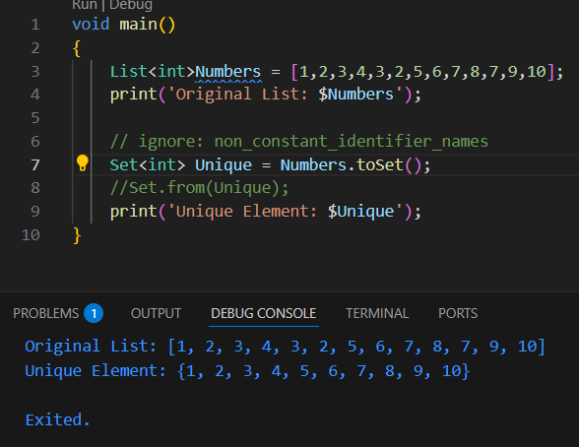
EXERCISE - 2
SET
IN
DART

Slide 17
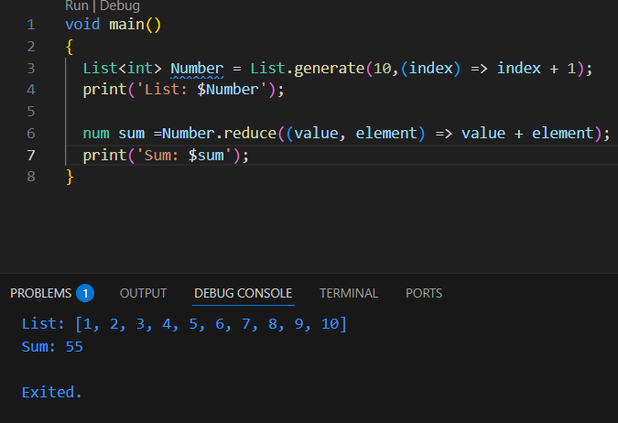
EXERCISE - 3
SUM
OF
ELEMENTS
IN
DART

Slide 18
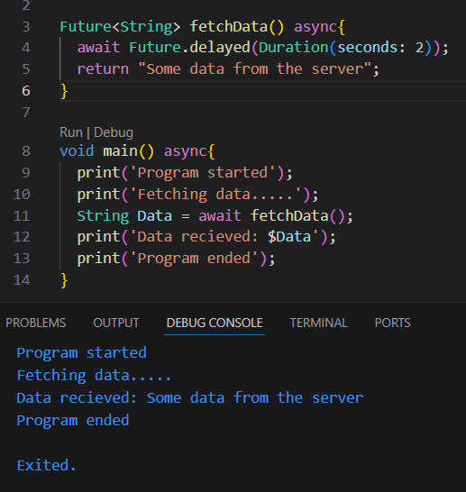
EXERCISE - 4
ASYNC
AND
AWAIT
IN
DART

Slide 19
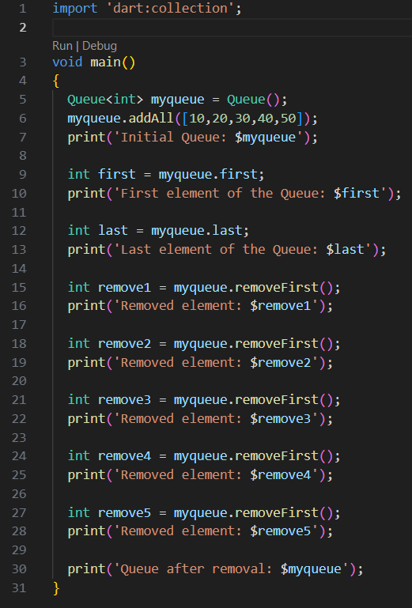
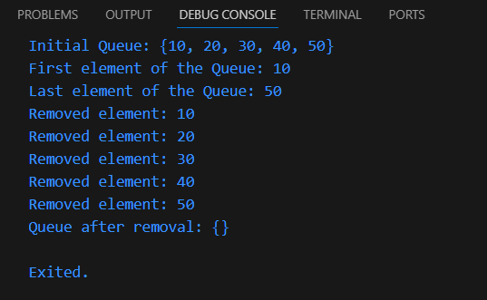
EXERCISE - 5
QUEUE
IN
DART

Slide 20
THANK
YOU !!

